Slide 1


SOFTWARE DONE RIGHT

Slide 2

Workshop
The Enigma Game

Slide 3
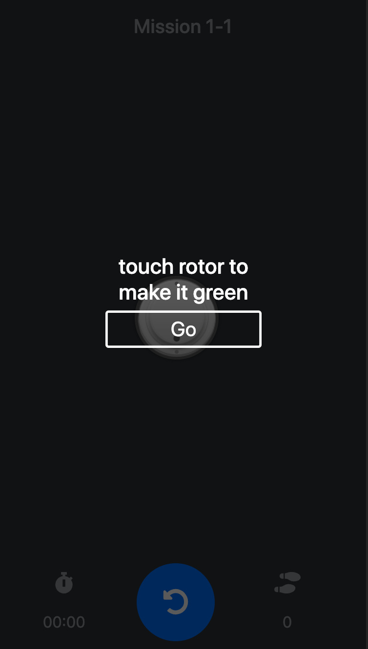
Splash Screen
Built-in directives
NgClass
The CSS classes are updated as follows, depending on the type of the expression evaluation:
string - the CSS classes listed in the string (space delimited) are added,
Array - the CSS classes declared as Array elements are added,
Object - keys are CSS classes that get added when the expression given in the value evaluates to a truthy value, otherwise they are removed.
<some-element [ngClass]="'first second'">...</some-element>
<some-element [ngClass]="['first', 'second']">...</some-element>
<some-element [ngClass]="{'first': true, 'second': true}">...</some-element>
<some-element [ngClass]="stringExp|arrayExp|objExp">...</some-element>
<some-element [ngClass]="{'class1 class2 class3' : true}">...</some-element>

Slide 4
Method 1
Look at : app/shared/splash/splash.component.html
<some-element [ngClass]="'first second'">...</some-element>
<div class="splash-wrapper" [ngClass]="'invisible'">
<div class="splash-wrapper" [ngClass]="'visible'">

Slide 5
Method 2
<some-element [ngClass]="expression">...</some-element>
<div class="splash-wrapper" [ngClass]="visibility">
app/shared/splash/splash.component.ts
get visibility() {
return this._visible ? "visible" : "invisible";
}

Slide 6
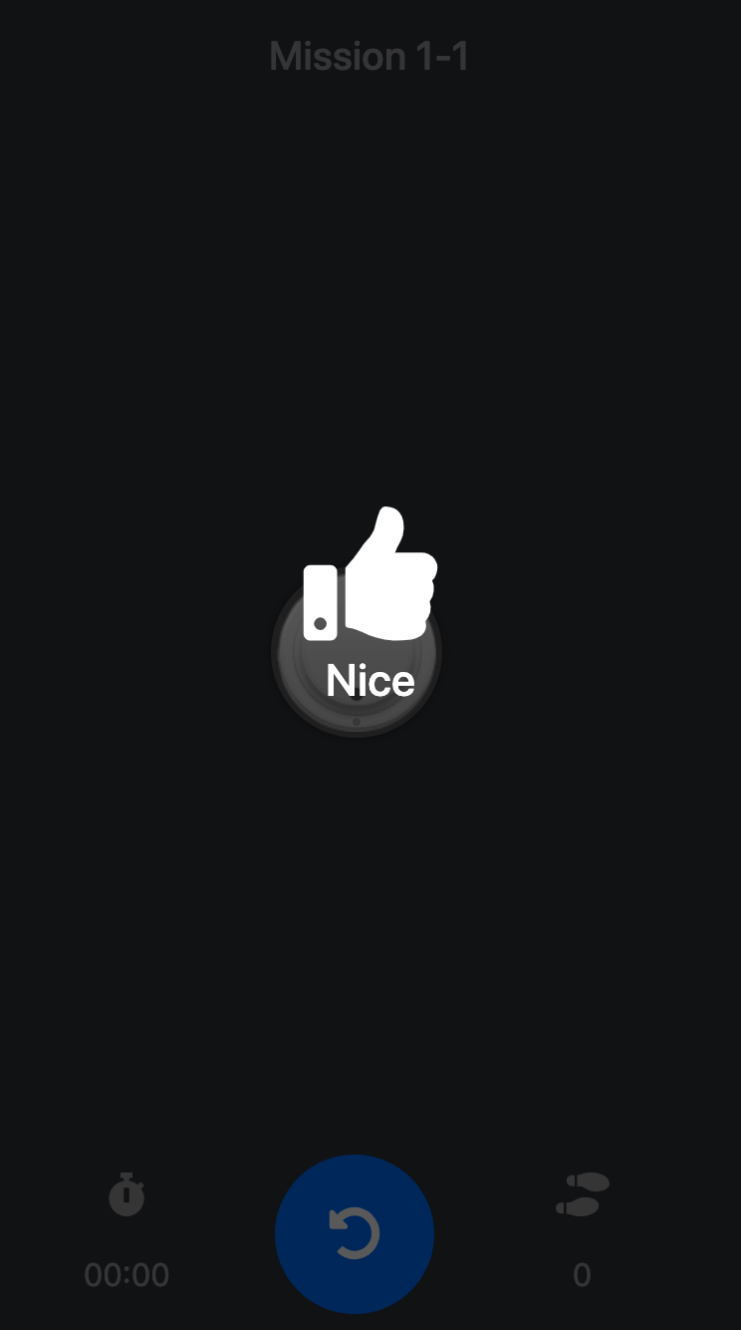
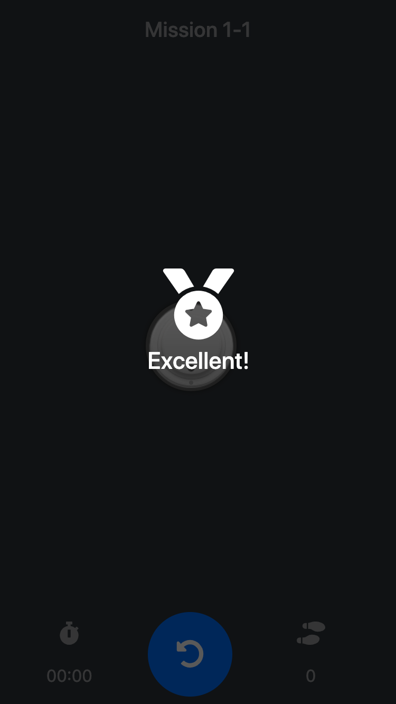
Control Splash Screen
<app-splash
[title]="cover"
[symbol]="symbol"
[visible]="steps.length === 0
&& cover != ''">
</app-splash>
<app-splash [title]="'Nice'" [symbol]="1" [visible]="unlocked && steps.length >
mission.answer"> </app-splash>
<app-splash [title]="'Excellent!'" [symbol]="2" [visible]="unlocked && steps.length <=
mission.answer"> </app-splash>

Slide 7
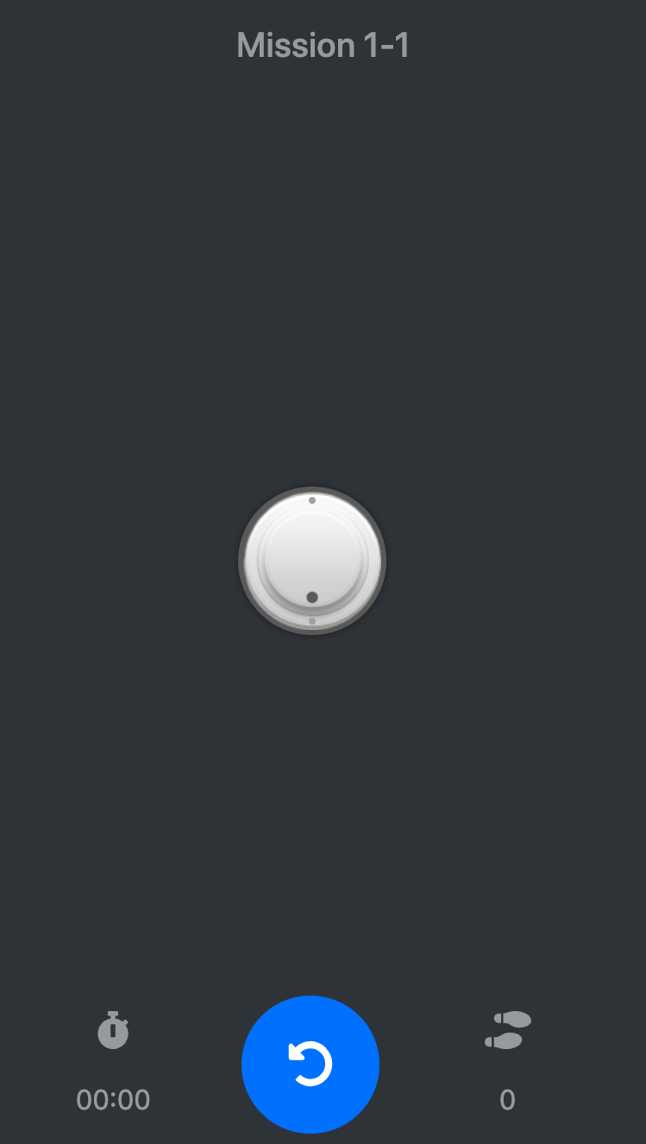
The Board & Rotor
Component Interaction
<app-rotor [rotor]="rotor"
@Input() rotor: Rotor;
Board
Component
Rotor
Component
(outDial)="onDial($event)">...
@Output() outDial
= new EventEmitter<string>();

Slide 8
The Board & Rotor
Events
(event)
In Angular, we can register and capture an event from an element by wrapping the event in a () parenthesis.
(click)="clickCallBack()"
(submit)="submitCallBack()"
(focus)="focusCallBack()"
(blur)="blurCallBack()"
(…)="...()"

Slide 9
Dial() Rotor
app/board/shared/rotor/rotor.component.html
app/board/shared/rotor/rotor.component.ts
<div class="knop" (click)="dial()">
dial() {
this.outDial.emit(this.rotor.id);
}
Board
Component
Rotor
Component
(outDial)="onDial($event)">...
@Output() outDial = new EventEmitter<string>();

Slide 10
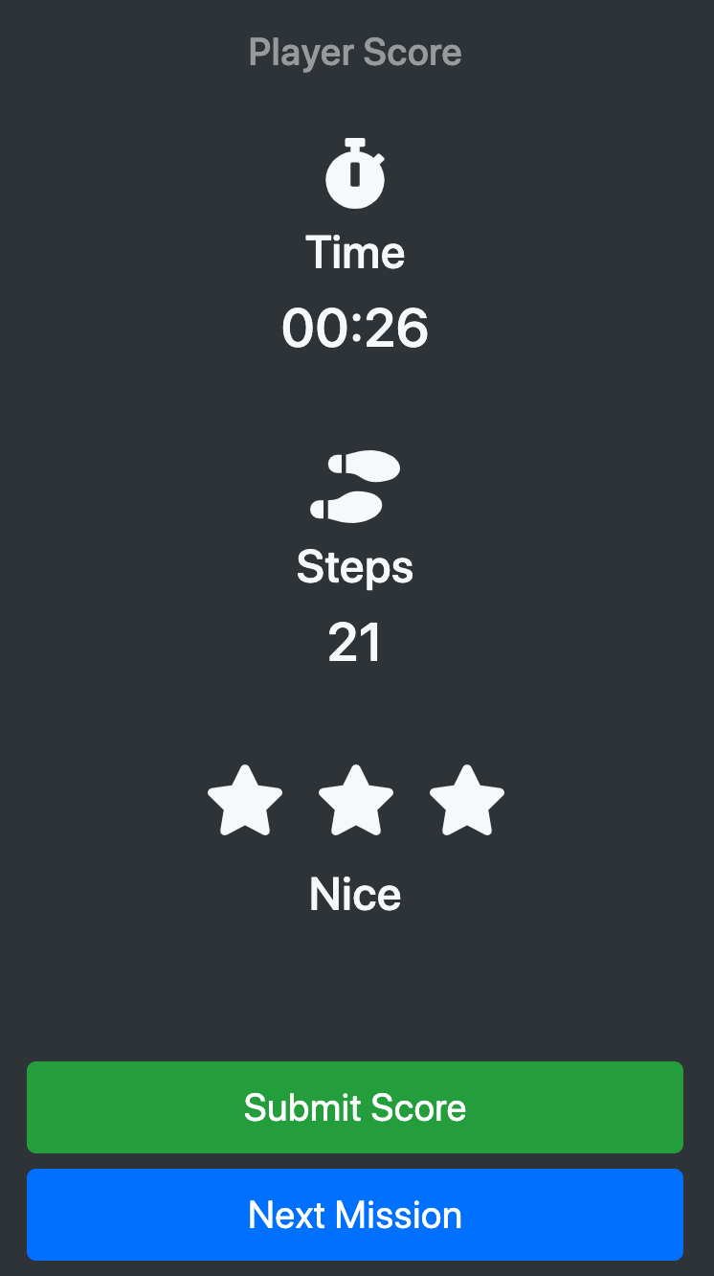
Player Score
Angular Pipes
To transform the data with " | " symbol
Look at : app/score/score.component.html
<span class="h3">{{ time | date:'mm:ss'}}</span>
Try : app/mission-score.service.ts
time: number = 60000;

Slide 11
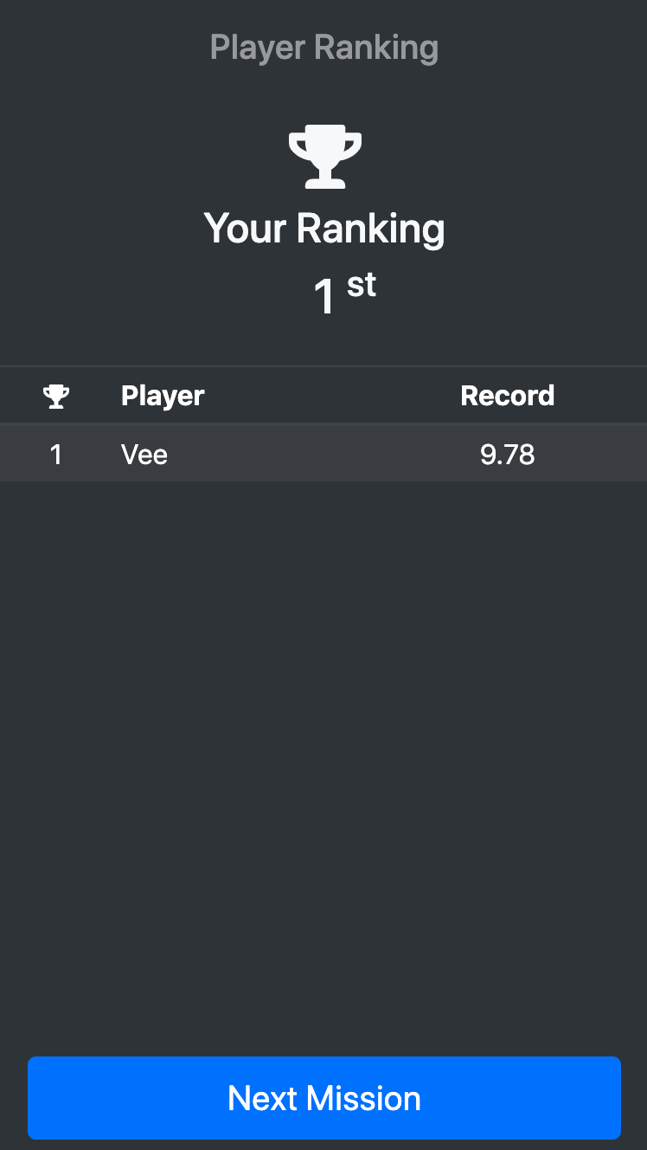
Player Ranking
Angular Services
Angular services are singleton objects which get instantiated only once during the lifetime of an application.
Look at : app/app.module.ts
@NgModule({
declarations: [
…,
ScoreComponent,
RankingComponent
],
providers: [
ApiService,
MissionService,
ProxyConfigService,
ScoreService
],..
})
@Injectable({
providedIn: 'root'
})
Score
Component
Score
Service
Ranking
Component
inject
inject
constructor( private _scoreService: ScoreService,..
constructor( private _scoreService: ScoreService,..

Slide 12
Player Ranking
Component Method
OnInit Interface
Look at : app/ranking/ranking.component.ts
ngOnInit() {
this._scoreService.get.score.list().subscribe(scores => {
scores.forEach(score => {
this._scores[score.player] = score;
});
});
}
Ranking
Component
Method
get.score.list
HTTP GET
/api/score/rank
Score
Service
API
Players Score
Model
JSON
Players Score

